Slide 1
1.17

Slide 2
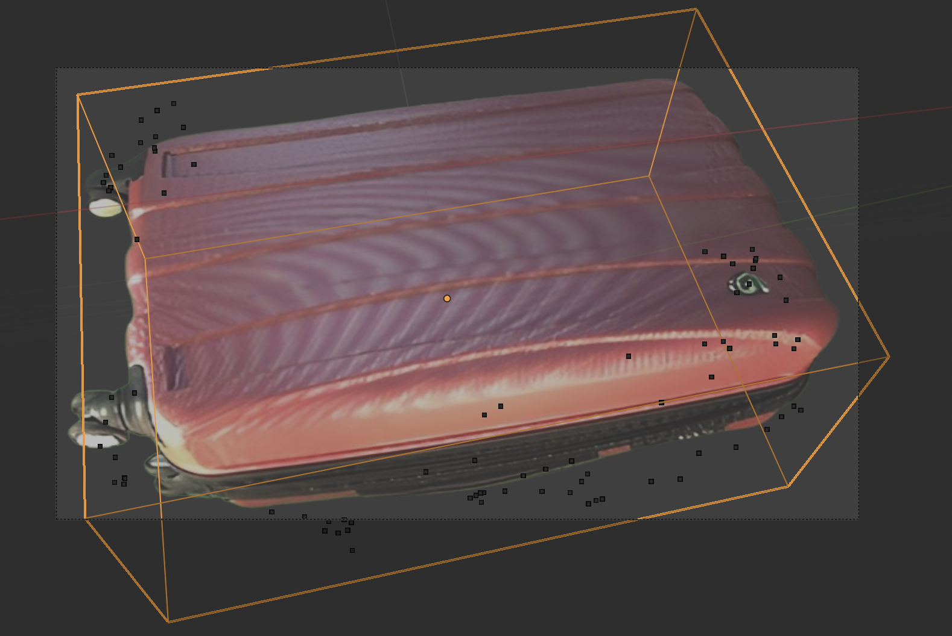
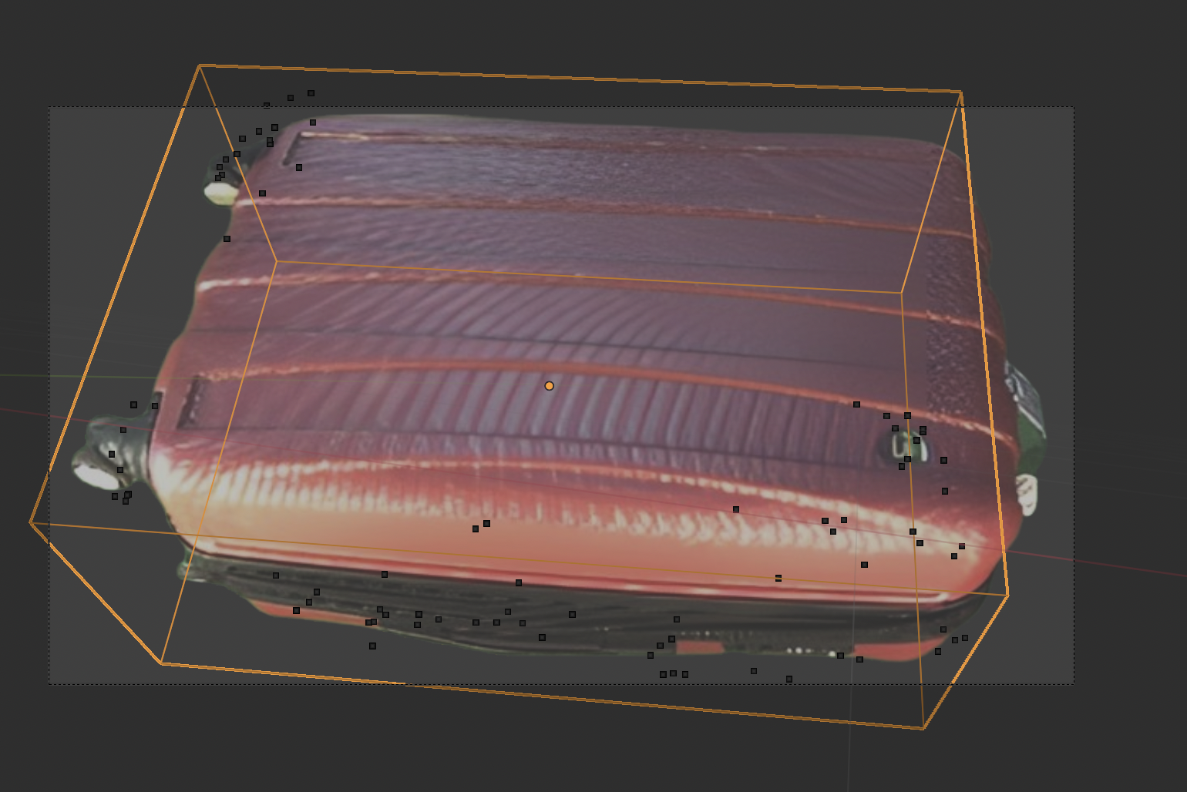
3d box on 2d images

Slide 3
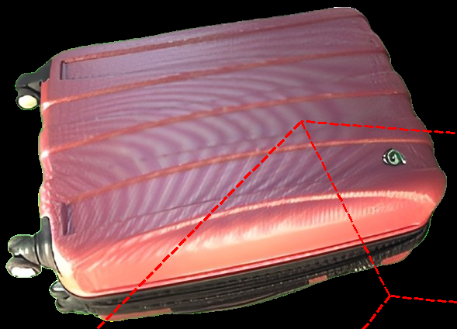
3d box on 2d images with mismatch.
Camera parameters
Camera Object: camxform_00000_1068303779_IDS_CAM1_2H_POS2__VI__1570032411-remo
matrix_world:
<Vector (0.9929, 0.1187, -0.0103, -0.9914)>
<Vector (-0.0099, -0.0040, -0.9999, -0.7336)>
<Vector (-0.1187, 0.9929, -0.0028, -0.0988)>
<Vector (0.0000, 0.0000, 0.0000, 1.0000)>
Lens (mm): 43.45584487915039
Sensor Width (mm): 36.0
Sensor Height (mm): 25.915109634399414
Sensor Fit: AUTO
Shift X/Y: 0.0, 0.0
Cube parameters
matrix_world:
<Vector (5.0157, -0.1758, -0.4260, -1.0002)>
<Vector (0.6896, 1.7728, 1.8849, 7.0103)>
<Vector (0.2888, -1.1789, 2.8980, -0.1064)>
<Vector (0.0000, 0.0000, 0.0000, 1.0000)>
Vertices (in world coords):
0: (-3.2070, 4.8367, -1.1104)
1: (-3.6331, 6.7216, 1.7876)
2: (-3.3829, 6.6095, -2.2893)
3: (-3.8089, 8.4944, 0.6087)
4: (1.8086, 5.5262, -0.8216)
5: (1.3826, 7.4111, 2.0764)
6: (1.6328, 7.2991, -2.0005)
7: (1.2067, 9.1839, 0.8975)

Slide 4
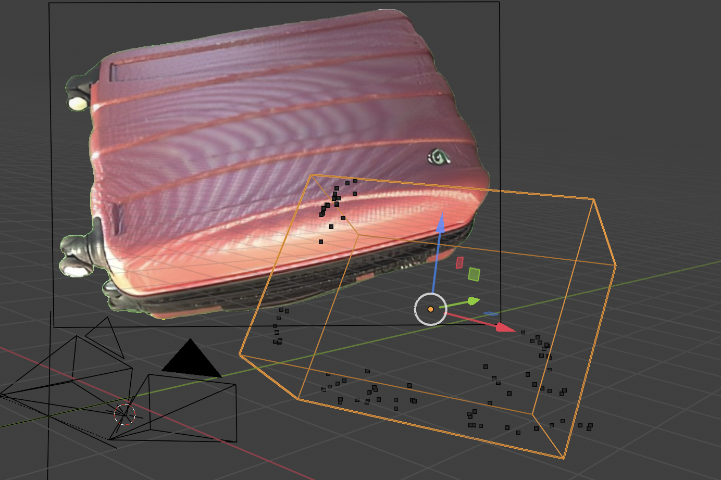
3d box on 2d images with mismatch.
The scene should be like here, based on the output of the Python executions

Slide 5
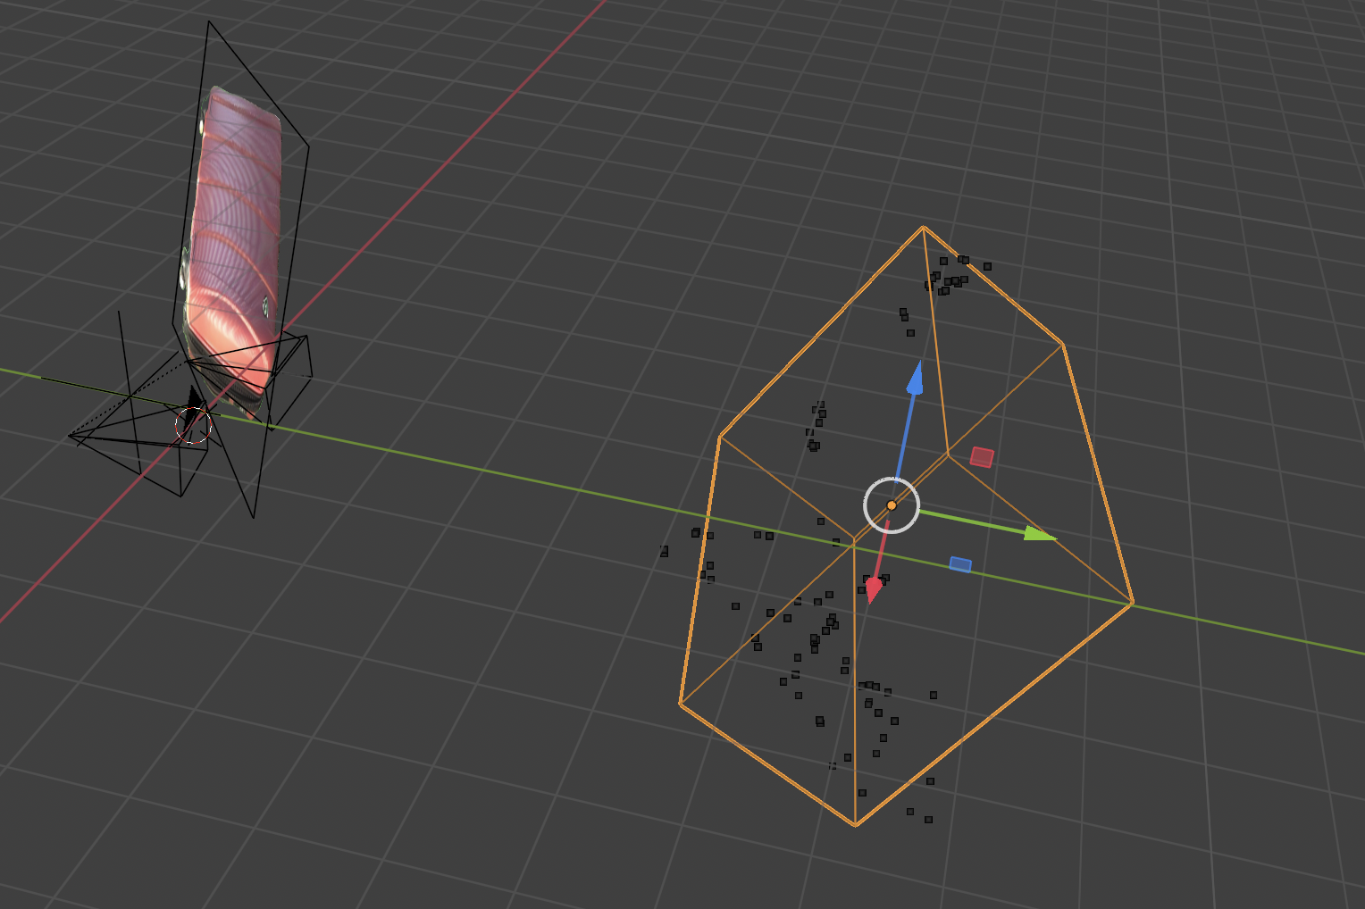
3d box on 2d images with mismatch.
The scene should be like here, based on the output of the Python executions
Background Image positions problems

Slide 6
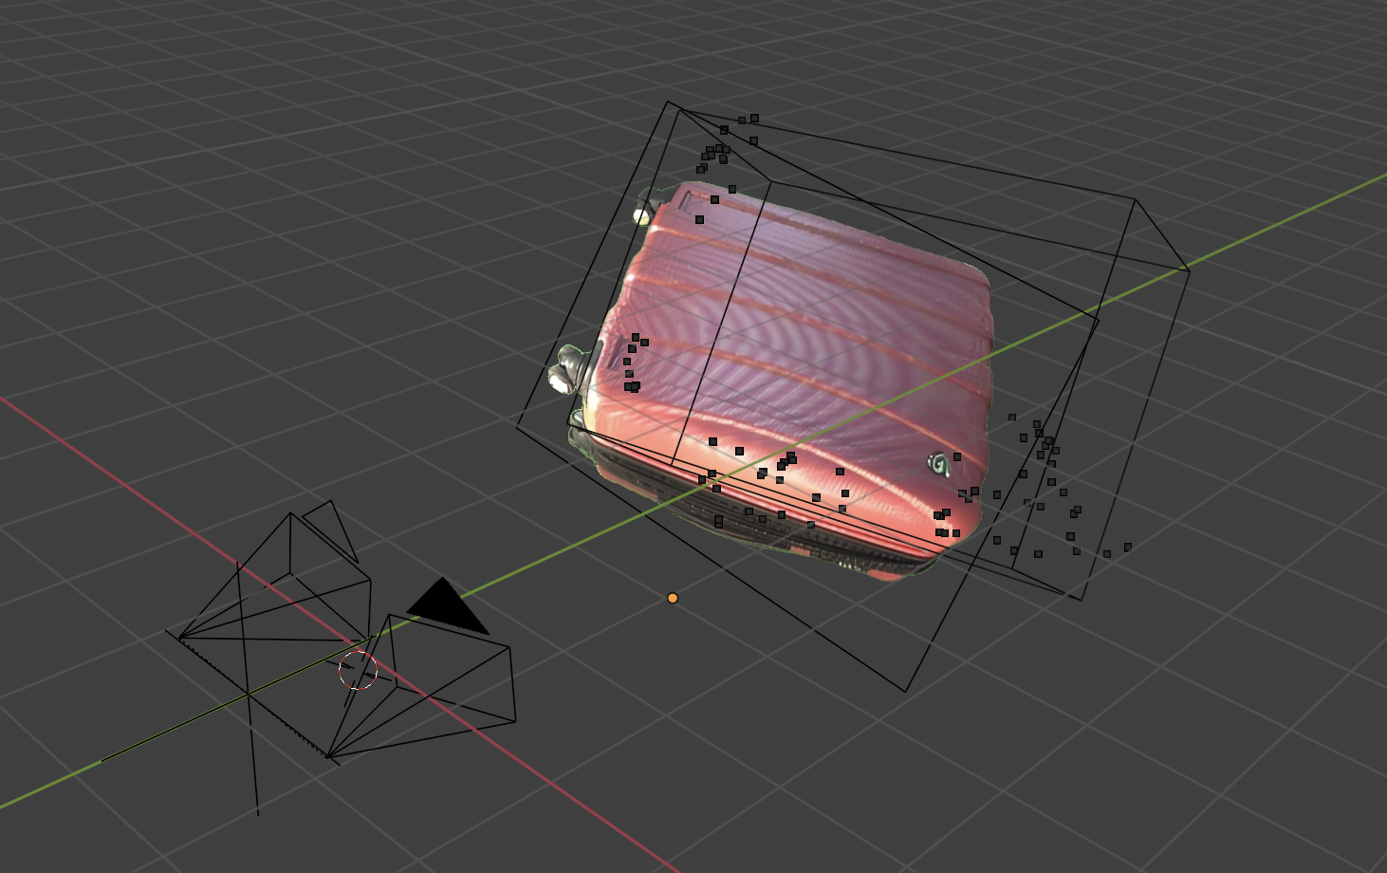
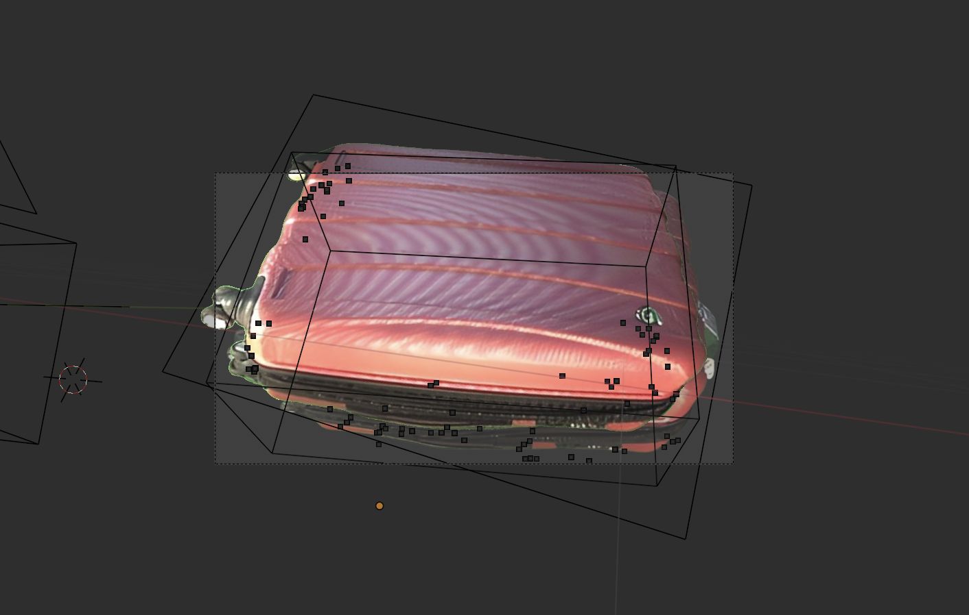
3d box on 2d image
Image position should be like this (match with the embedded background in camera)

Slide 7
3d box on 2d images with mismatch.
The Key parameters for the background image
2025-01-17 14:21:08.910 Blender[80476:9003632]
TSM AdjustCapsLockLEDForKeyTransitionHandling - _
ISSetPhysicalKeyboardCapsLockLED Inhibit
Image Filepath: //pureImage1.png
Image Name: pureImage1.png
Width, Height: 589 x 424
Offset X: -0.8220499753952026
Offset Y: 4.01971435546875
Scale: <Vector (1.0000, 1.0000, 1.0000)>
Embedded Background has no properties
No objective and parameters

